Slide 1



Hand Sign Detection
Using CNN
Muhammad Jamal Anjum

Slide 2


Introduction
Hand gestures are a natural form of communication with applications like sign language translation and touchless control. Recognizing them is challenging due to variations in shape, orientation, and lighting. Convolutional Neural Networks (CNNs) can automatically learn image features, and in this project, we use both predefined and custom CNNs to classify hand signs accurately.

Slide 3

Some Visual Representation of Images from the Dataset
Represent
A
Represent
B
Represent
C

Slide 4

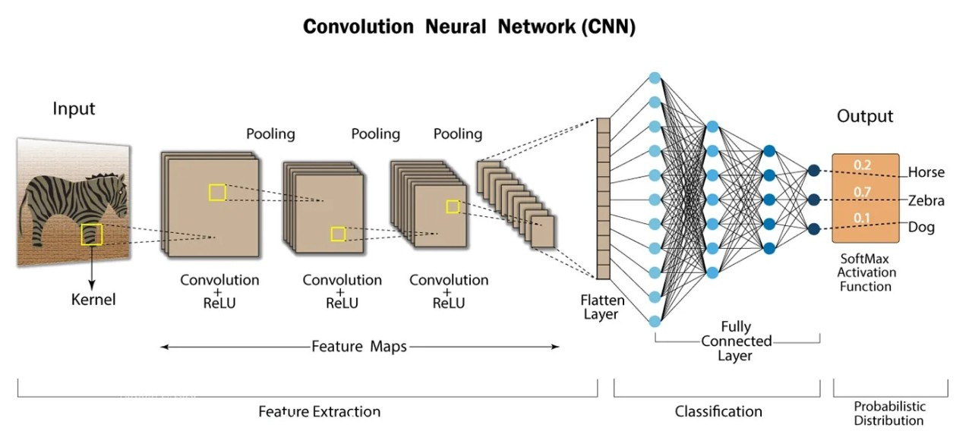
Working of CNN

Slide 5
Phases of this Project
Loading/Resizing
Agumentation/Blancing
Convolutions/
Backpropogation
Training

Slide 6
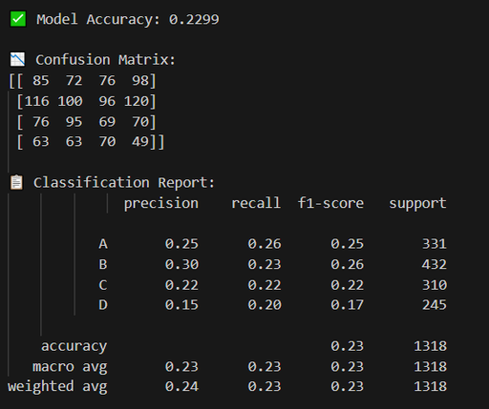
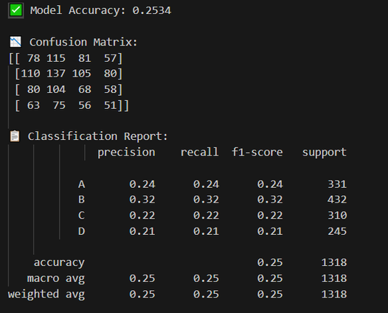
Before Agumentation of Dataset
  The model’s training accuracy was roughly 92%.
  But I was getting test accuracies not up to 30% even after trying several times.
What was the Issue
I observed that my dataset is imbalanced, which is likely why the model achieved high training accuracy but poor test accuracy. This phenomenon is known as Overfitting.

Slide 7

Problem
  Using Bigger batch size with small Dateset.
  Deminsion of the image is so small there we dont need more feature extractions
  Imblancing in the Classes model traing better with bigger sample.
  Overfitting of the dataset and need to be blanced.

Slide 8
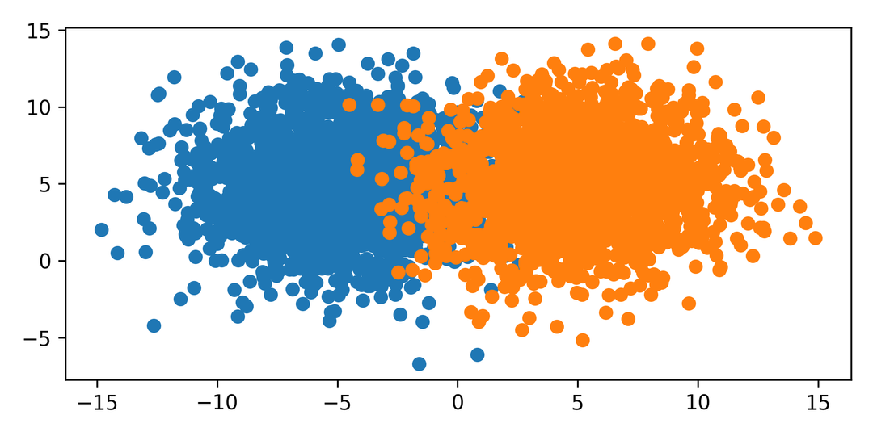
After Blancing the Dataset
  After balancing the dataset, I observed a significant improvement in model performance.
  The testing accuracy increased to around 96%, indicating better generalization.
  I also noticed a substantial reduction in loss values.
  With balanced classes, the model achieved higher accuracy and excellent F1-scores on the test dataset.

Slide 9
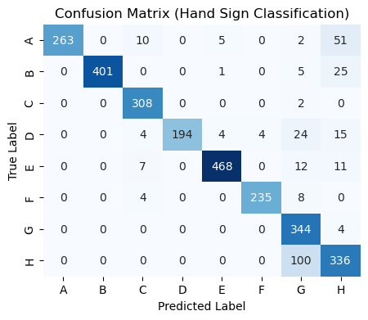
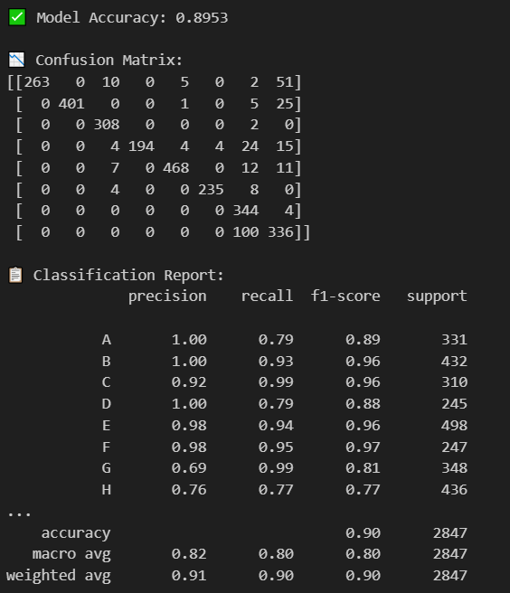
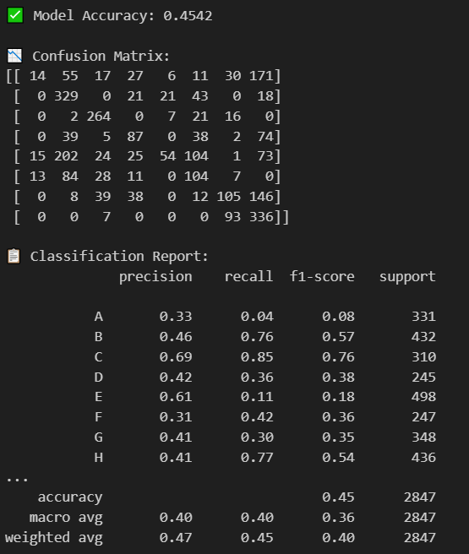
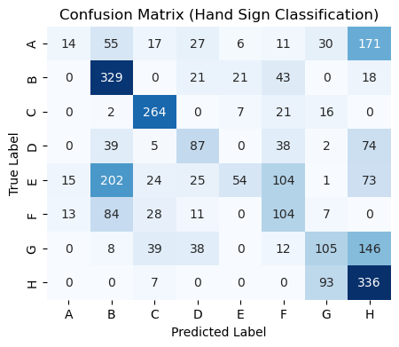
Custom CNN
Custom CNN
Custom CNN
Resnet50
ResNet50

Slide 10
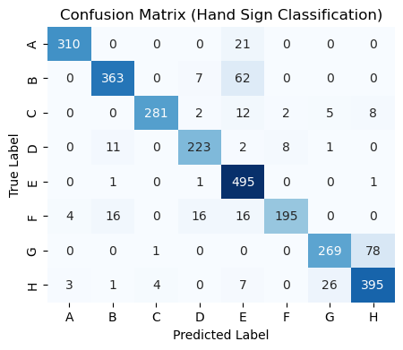
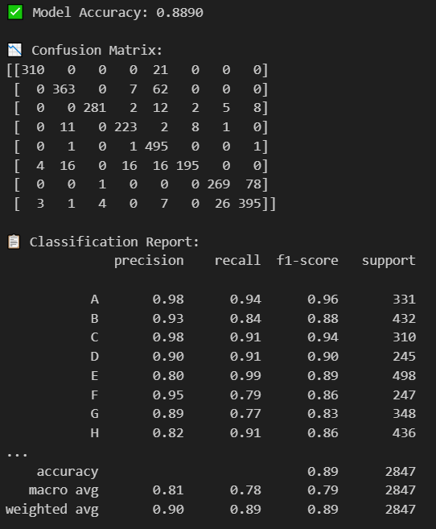
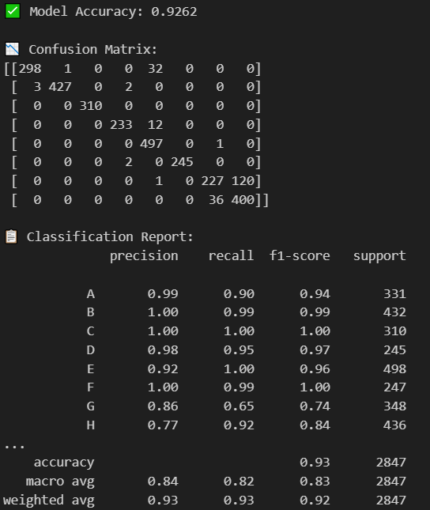
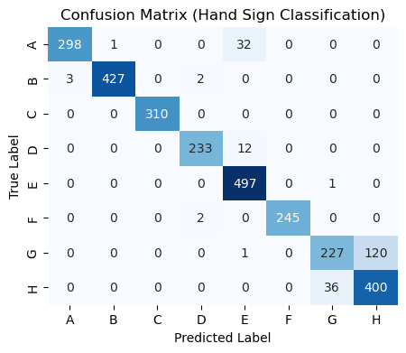
MobileNetV2
MobileNetV2
Resnet50
DenseNet121

Slide 11
Thank You

